Slide 1
Open and Virtualized Networks
s263697
Idri Hoxha

Slide 2
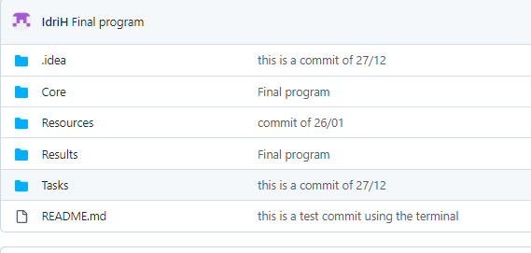
The program file structure:

Slide 3
Graphical OO representation
Network
Network
1
1
Propagate
2*
*
Node
Propagate
Line
2
*
Connection
Signal info
Lightpath

Slide 4
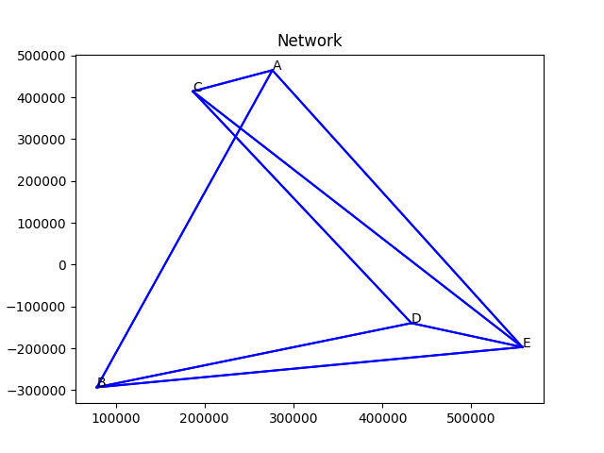
Topology

Slide 5
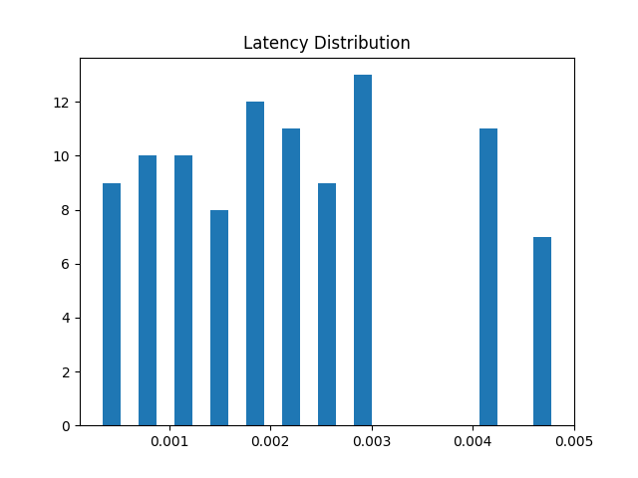
Network Latency :
Average latency : 0.0022054959267854566 s

Slide 6
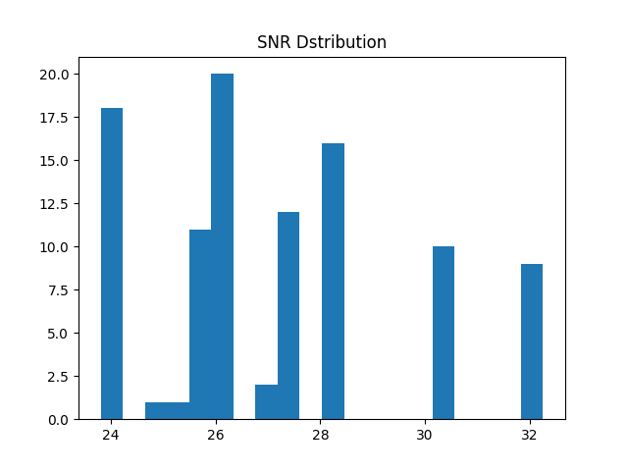
Network SNR
Average SNR: 27.21551255527202 db

Slide 7
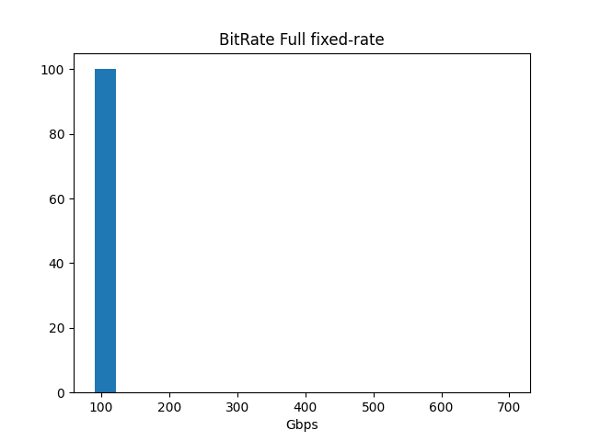
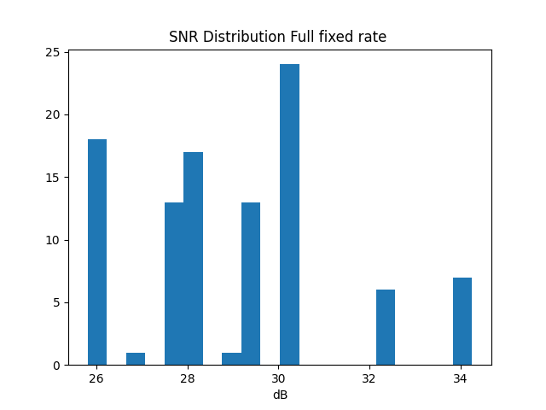
Results : Streaming 100 random connections using different transceiver technologies |B2| = 0.6 e-26 (mHZ^2)^-1
Full fixed rate
Total Capacity Fixed-Rate: 10000 Average Capacity Fixed-Rate: 100.0

Slide 8
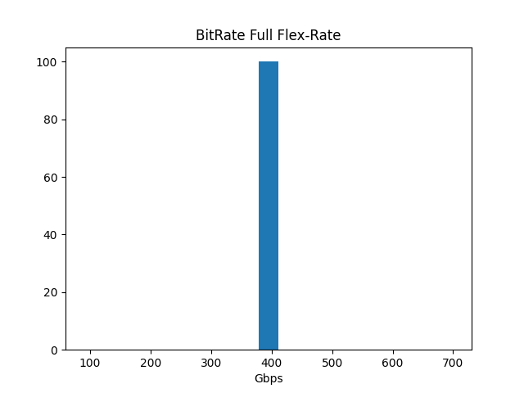
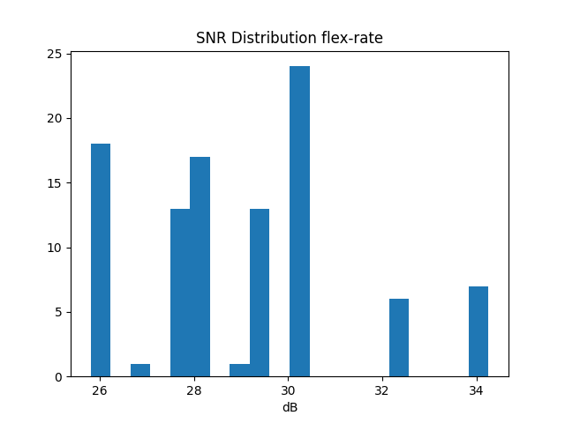
Full flex rate
Total Capacity Flex-Rate: 40000 Average Capacity Flex-Rate: 400.0

Slide 9
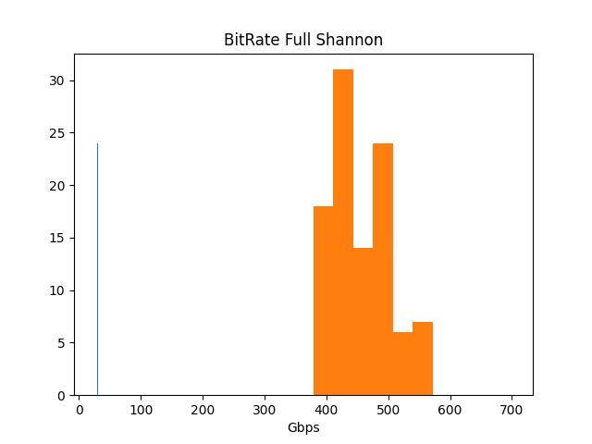

Shannon
Total Capacity Shannon: 45991.16 Average Capacity Shannon: 459.9123

Slide 10

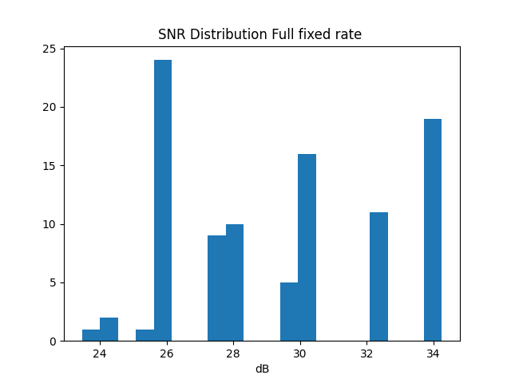
Results : Streaming 100 random connections using different transceiver technologies |B2| = 2.13e-26
Full fixed rate
Total Capacity Fixed-Rate: 9800 Average Capacity Fixed-Rate: 100.0

Slide 11


Full flex rate
Total Capacity Flex-Rate: 39200 Average Capacity Flex-Rate: 400.0

Slide 12
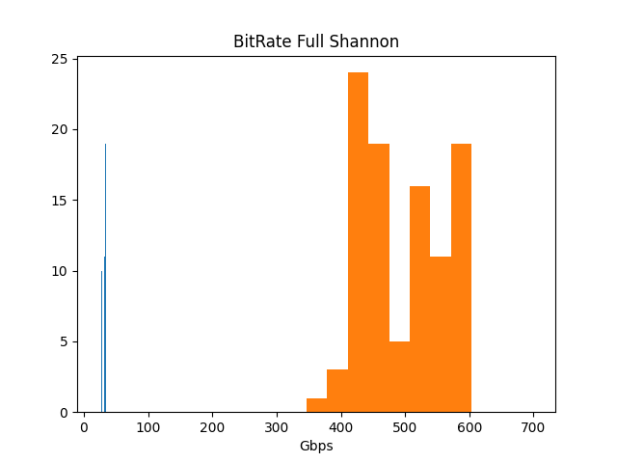

Shannon
Total Capacity Shannon: 48782.23 Average Capacity Shannon: 497.77959183673465

Slide 13
Increasing B from 0.6e-26 to 2.3e-26
B2 is proportional to signal power
B2 increase => Sig.power increase => SNR increase
Capacity increase

Slide 14
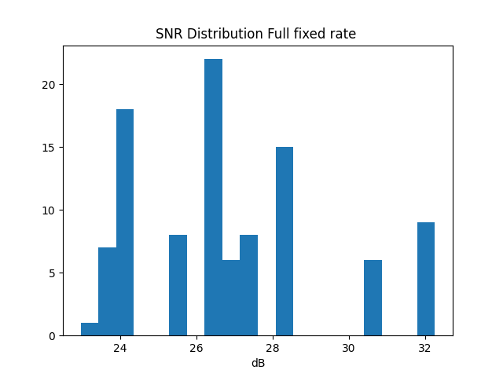
Setting NF from 3 to 5
Full fixed rate
Total Capacity Fixed-Rate: 10000 Average Capacity Fixed-Rate: 100.0

Slide 15
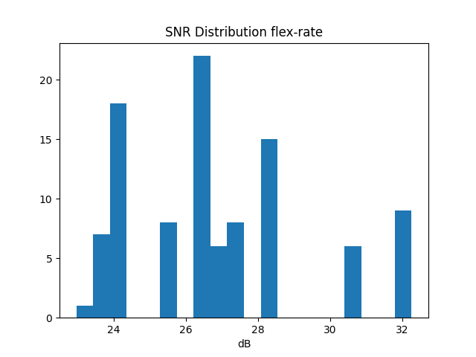
Full Flex rate
Total Capacity Flex-Rate: 40000 Average Capacity Flex-Rate: 400.0

Slide 16
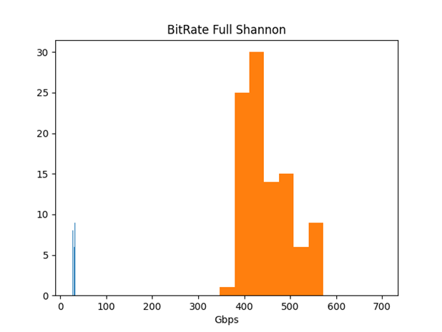

Shannon
Total Capacity Shannon: 45488.7 Average Capacity Shannon: 454.88730000000004

Slide 17
Increasing the noise figure increases the power of ase (amplified spontaneous emissions)
Which decreases the GSNR
=> decreases capacity

Slide 18
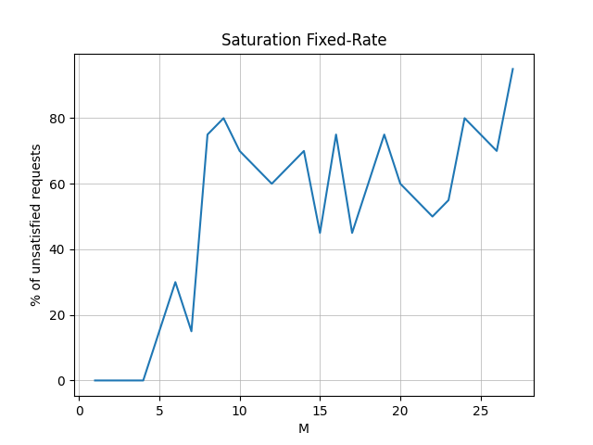
Traffic Matrix saturation 90%

Slide 19
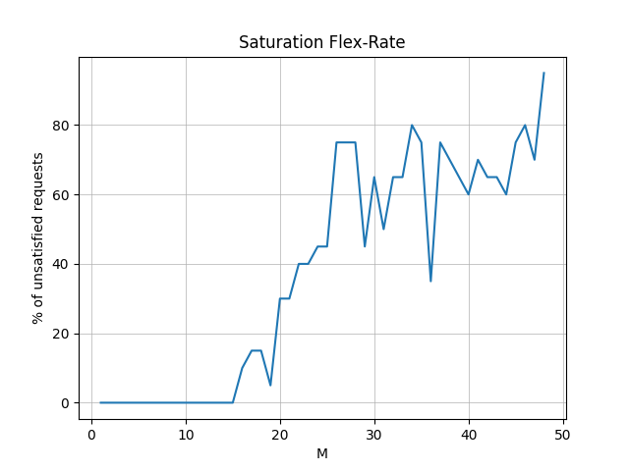

Slide 20
